Slide 1
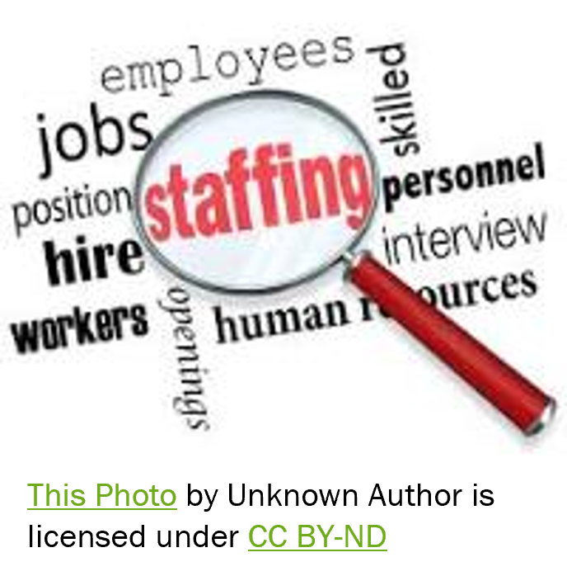
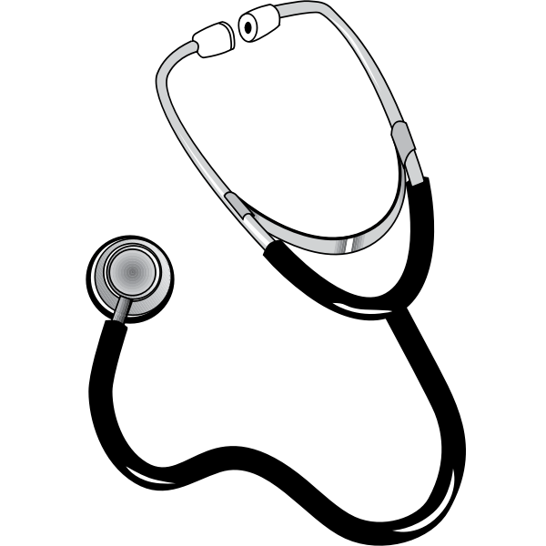
Nursing Shortages & Effects on Healthcare
Savanna Coiner, Jenifer Salmeron, Kaitlyn Sarcona, Ronald Fontenot

Slide 2
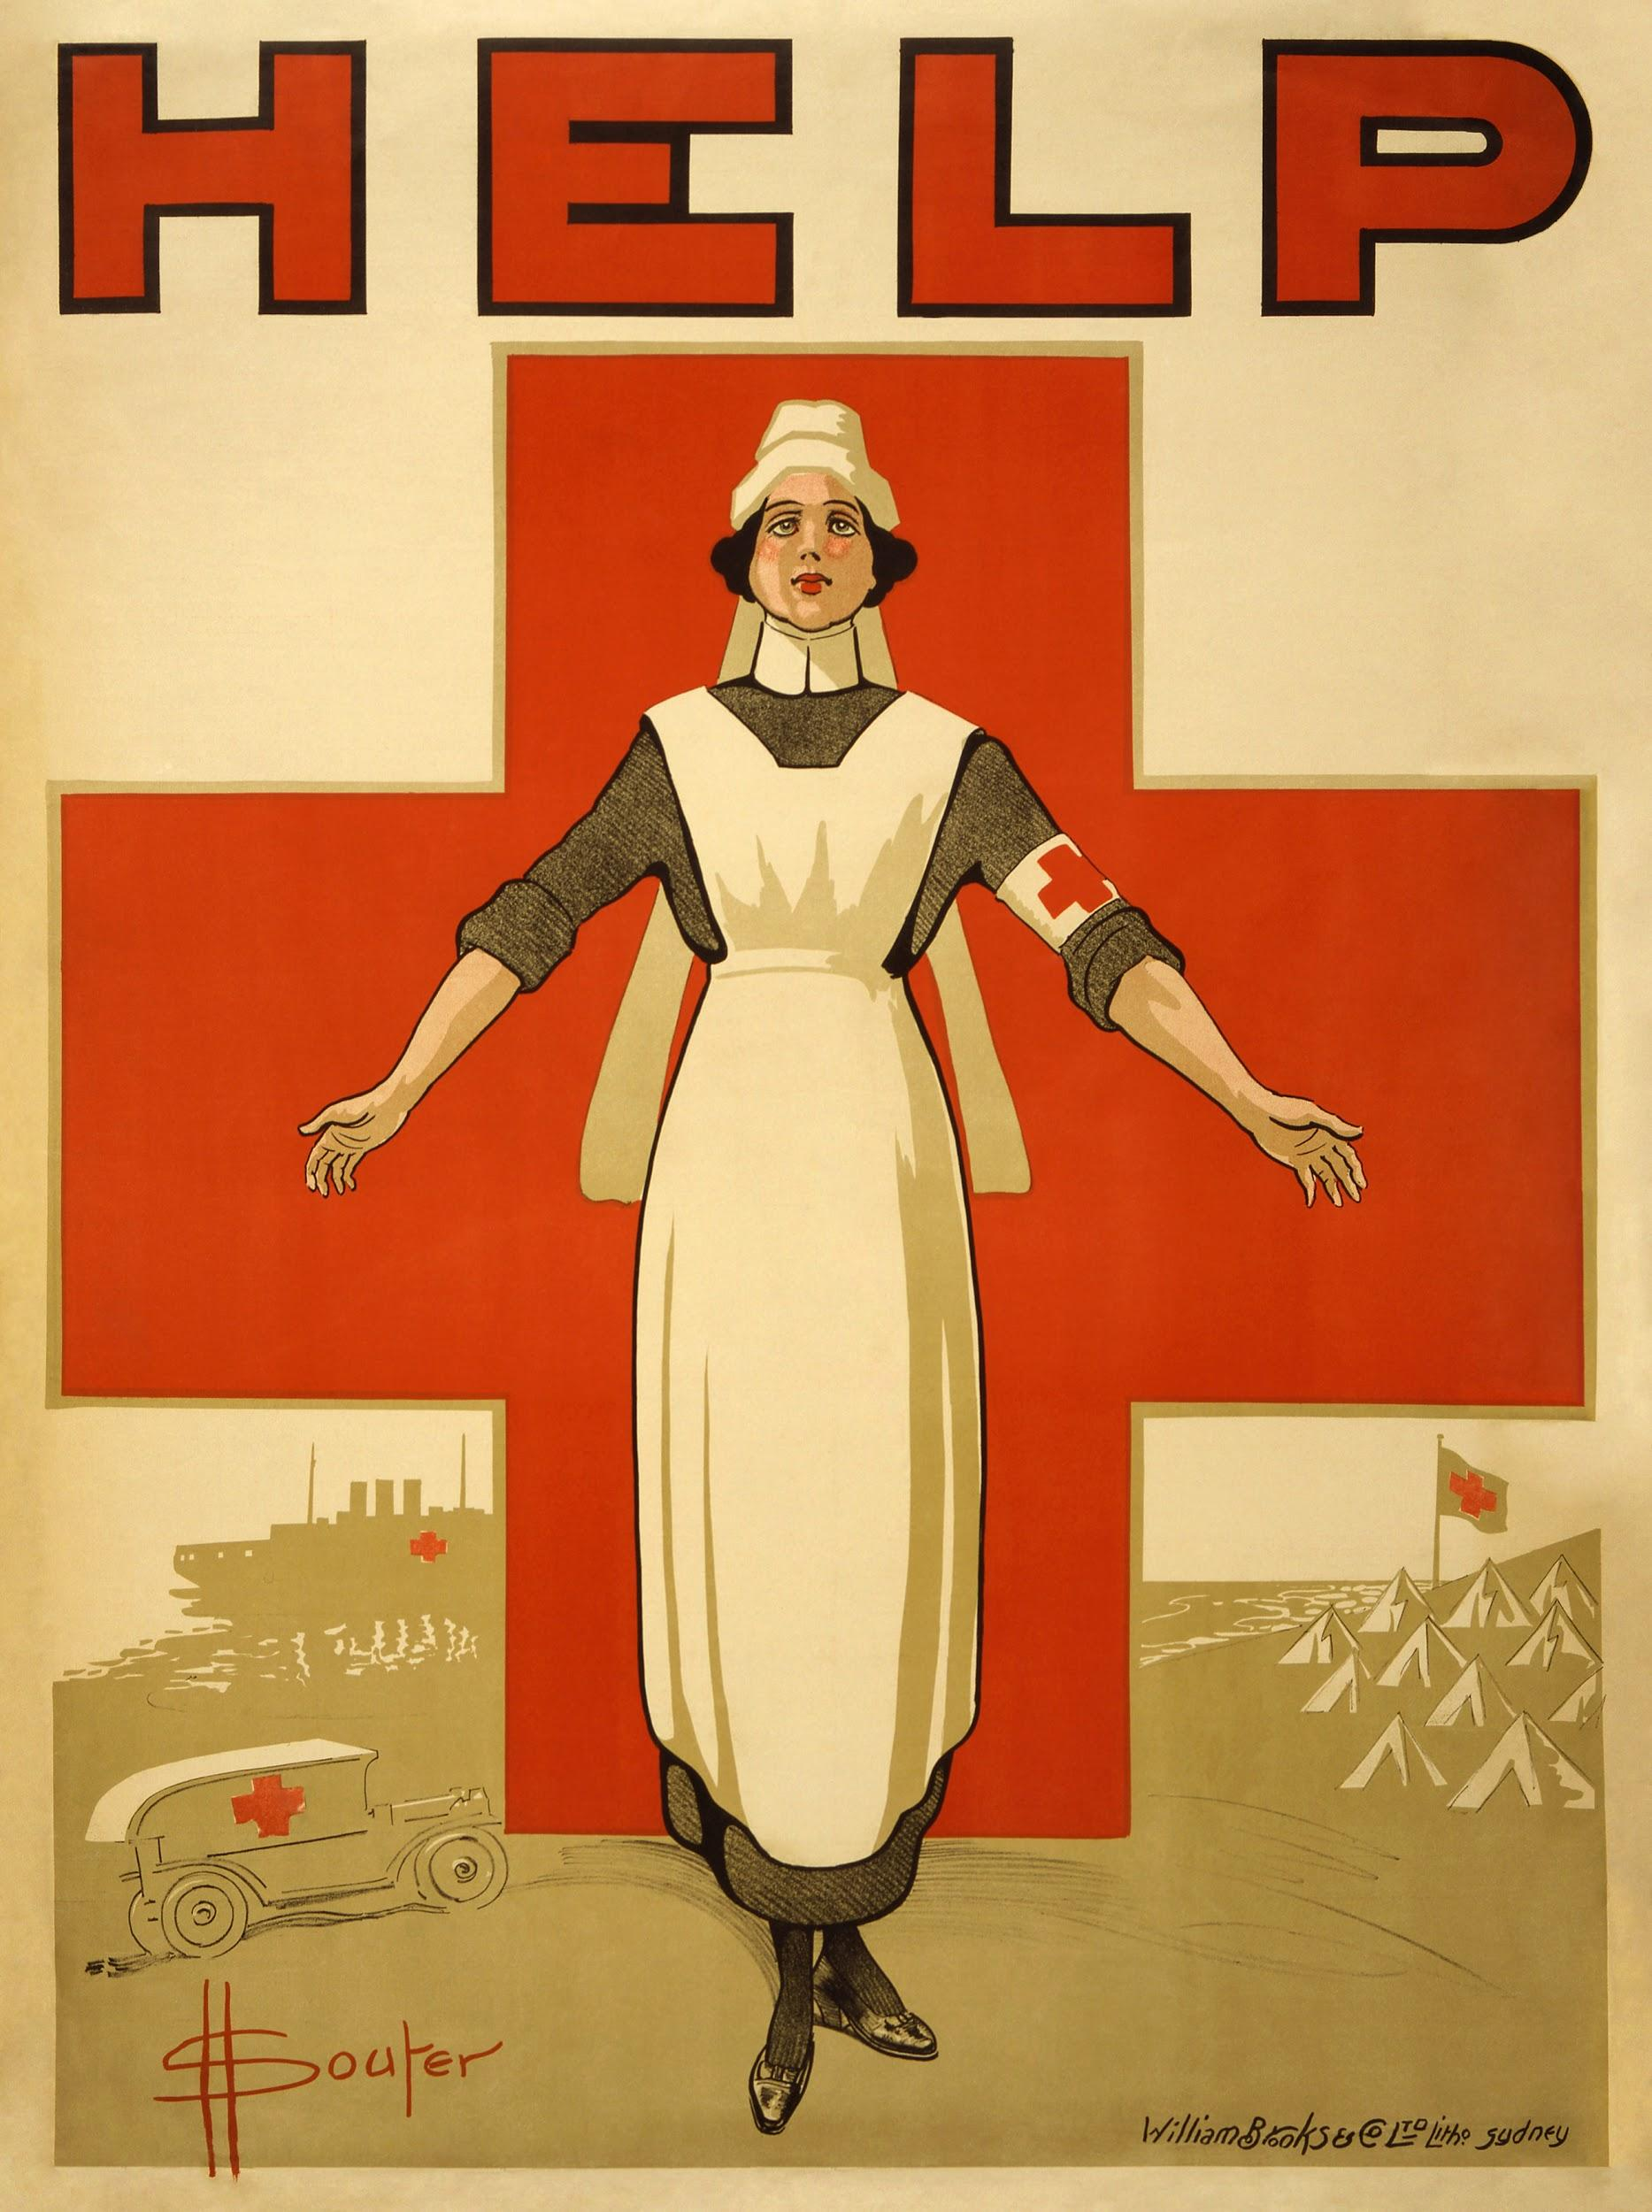
Nursing Shortage
The American Association of Colleges of Nursing reports that the U.S. is projected to experience a shortage of RNs that is expected to intensify as Baby Boomers age and the need for health care grows (AACN, 2020)
Covid-19 Pandemic has exacerbated this issue with limited resources and staff
This shortage is expected to continue through 2030 (Mehdaova, 2017)
In this presentation we take a look at
Current factors affecting this nursing shortage, explain why this shortage is of concern for everyone
Explain why this shortage is of concern for our fellow colleagues and everyone we care for
Identify strategies and initiatives to alleviate the shortage using collaboration with policy makers and interprofessionals to adapt and implement such strategies and initiatives
Describe why it is important to follow up with evaluation of the effectiveness of these initiatives to help mitigate critical nursing shortage
The 2021 American Nursing Shortage: A Data Study | University of St. Augustine for Health Sciences (usa.edu)

Slide 3
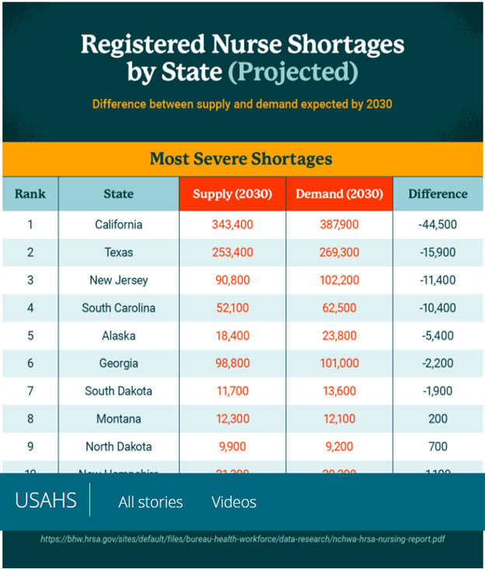
Nursing Shortage Statistics
“In a Health Affairs blog posted in May 2017, Dr. Peter Buerhaus and colleagues project that more than 1 million registered nurses will leave the workforce by 2030” (AACN, 2020).
The University of St. Augustine for Health Sciences compiled this table indicating the difference between supply and demand expected by 2030 Source: Pascale Carayon and Ayse Gurses, “Chapter 30: Nursing Workload and Patient Safety—A Human Factors Engineering Perspective,” Patient Safety and Quality: An Evidence-Based Handbook for Nurses: https://www.ncbi.nlm.nih.gov/books/NBK2657/

Slide 4


Factors Affecting Nursing Shortage
High Demand-“As of February 2021, registered nursing was the fifth-most in-demand job in the American workforce, according to LinkedIn. Healthcare facilities are searching for skilled RNs because they are facing increased patient demand for care”(USAHS, 2021). Longer life spans and increase of aging population demand more from our strained healthcare system.
Retiring Nurses- A large portion of nurse workforce is close to retirement. “According to a 2018 National Sample Survey of Registered Nurses conducted by the Health Resources and Services Administration found that the average age for an RN is 50 years old, which may signal a large wave over the next 15 years (AACN, 2020).
-Some healthcare workers chose to retire early after the start of the pandemic, leaving a large gap in the workforce. Many nurses that were at retirement age who were still working at the start of the pandemic, left the profession for fear of contagion.
Location- Indiscrepancies exist when looking at nursing shortages nationally, state by state is more accurate. “ The Bureau of Health Workforce projects that California will face the largest nursing shortage of any state, with a projected shortfall of 44,500 nurses by 2030. In contrast, the state of Florida will have a projected surplus of more than 53,000 RNs by 2030” (USAHS, 2021). Rural communities will suffer the blount of nursing shortages more than metropolitan areas. “16% of RNs live in rural areas, where they serve over 52 million Americans who reside there”(USAHS, 2021)

Slide 5
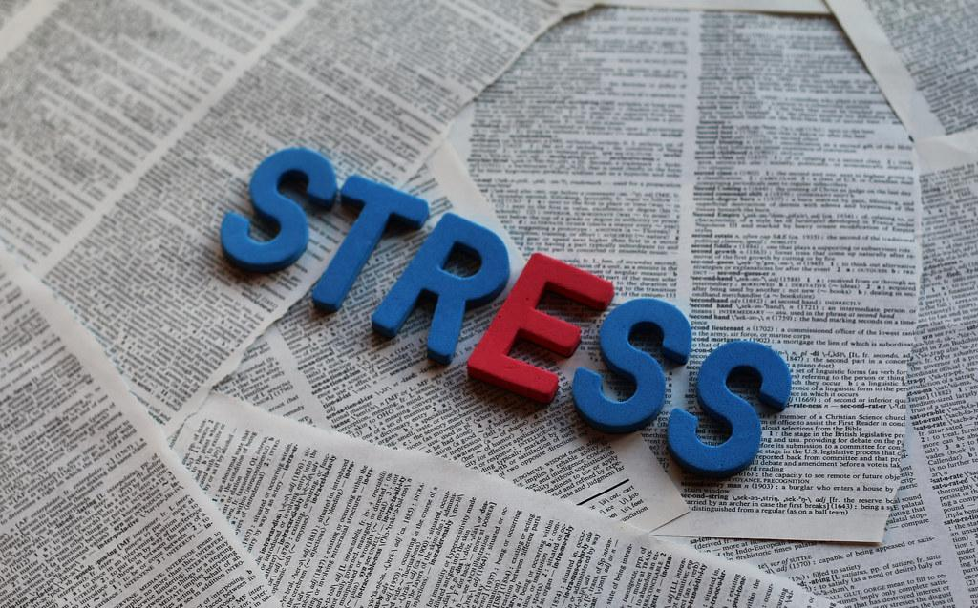
Factors Affecting Nursing Shortage
Decrease in Nurse Educators- many nurse educators are close to or at retirement.
USAHS reports, “ One recent report discovered that, in 2020, over 80,000 qualified nursing school applicants were turned away from baccalaureate and graduate programs due to a lack of qualified faculty, clinical study sites, classroom space, and budget constraints” (USAHS, 2021). Less nursing faculty equals less nursing graduates joining the labor force
Stressful Environment- Nursing is stressful as it is, even more so with the pandemic. Staff cuts, longer hours, stress of bringing the virus home to families, and the stress of making urgent life altering decisions throughout the day can weigh heavy on a nurse’s life.

Slide 6
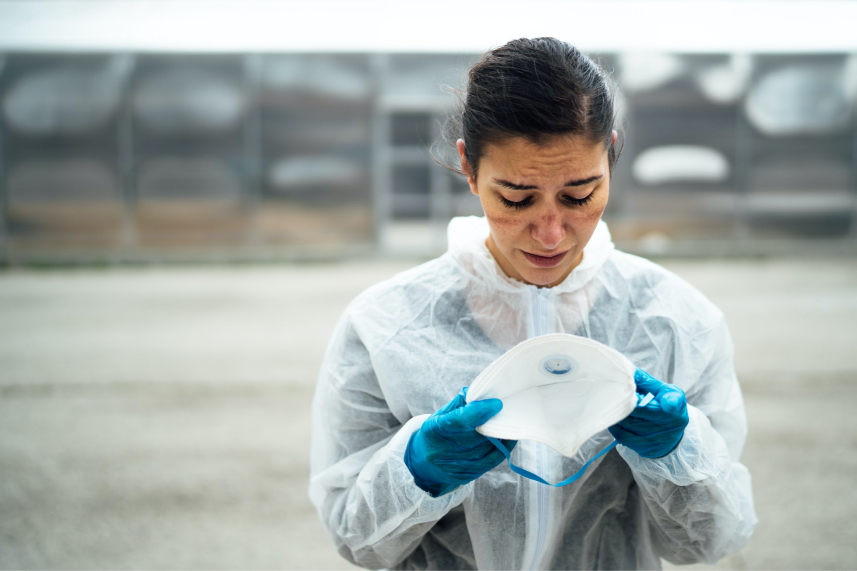
NURSE BURNOUT
“The heightened stress levels of today’s nurses are due to more than just the pandemic, more than just the need to make urgent life-altering decisions, and more than just working long hours. It is all of these things and more, combined, that weigh on the shoulders of many RNs.”(USAHS, 2021)
“I have missed kids’ school events, I have been short-tempered when I shouldn’t have been, and I have compromised my own health at times due to my inability to say ‘no’ to the extra shifts even on days when I knew I should.”
—Heather Josey Thomas (USAHS, 2021)
Nursing “burnout” is a phrase that is used in the nursing field to represent the absolute physical and mental exhaustion nurses and healthcare providers experience after repeatedly working with heavy caseloads, unfair nurse to patient ratios, long hours, and critically ill patients.
Nurses caring for critically ill patients are responsible for making life altering decisions on a daily basis. A clear head and ability to focus is essential to maintain patient care.
Working in a unit that is understaffed has the possibility of incorporating the following scenarios:
A nurse will be floated from another floor to assist, which increases chances for error and higher levels of stress, especially when asked to work with critical patients.
The nurse will be asked to care for an additional patient, increasing their workload and disrespecting safe nurse to patient staffing ratios.
Each of these events occurs commonly in hospitals and in turn increases the chances of nurse burn-out, medical errors, and decreased patient care.

Slide 7
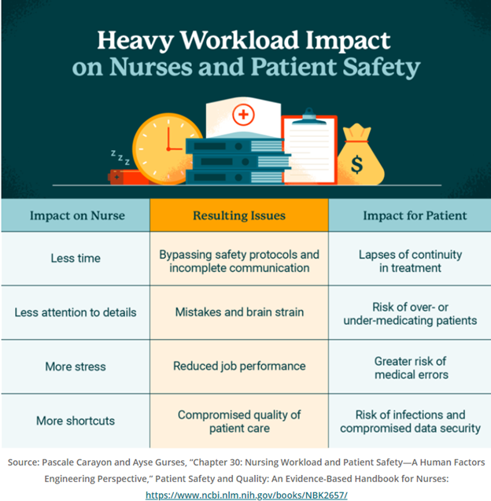
Causes for Concern
(USAHS, 2021)

Slide 8
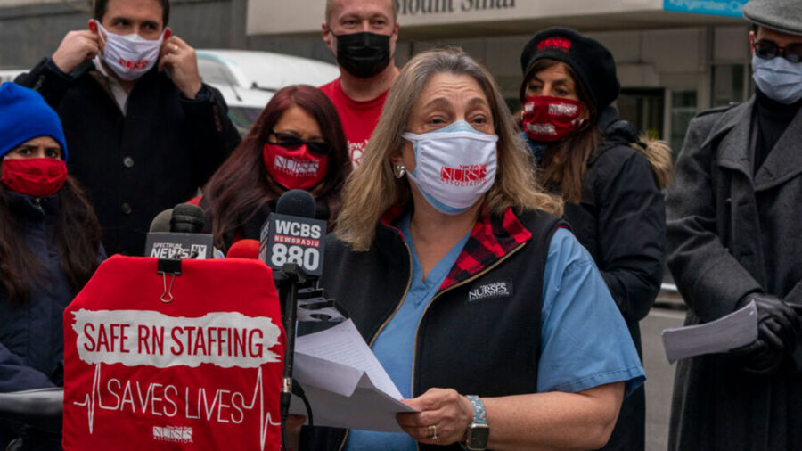
How the nursing shortage affects healthcare
Higher risk of medication errors and patient deaths.
“A 2018 study published in the medical journal The BMJ found the risk of death increases by 3% for every day a patient is treated in a facility that has a nursing shortage.” (OSU, 2020)
Fewer nurses must care for more patients.
Stressful work environment promotes the loss of motivation in nurses increases nurses productivity and promotes absenteeism.
Overworked nurses have less time to communicate with patients and colleagues.
“A study conducted in the United States statistically demonstrates that an increase of nurses’ workload was associated with a decrease of patient satisfaction, a worsening of outcomes and an increase of nosocomial infections.” (Peters, 2020)

Slide 9

What’s the solution?

Slide 10
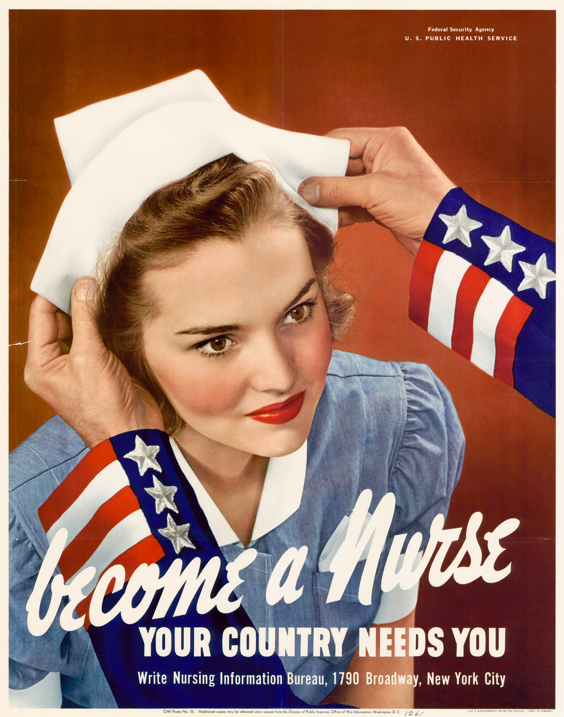
Nursing Shortage Solutions: Where Do We Go from Here?
In Search of Nursing Shortage Solutions
Finding nursing shortage solutions isn’t easy. It’s a complex problem, and it will take time to resolve. However, there are ways healthcare organizations and working nurses can start addressing the issue, such as by:
Using travel nurses: Travel nurses are a great solution when your workplace is overwhelmed due to a natural disaster or an illness outbreak.
Offering compensation for relocation: Though it may not always be possible for your employer to offer, providing broader compensation packages is often an excellent incentive to draw nurses from states of excess nurses to those of deficit.
Providing and encouraging growth opportunities: You are more likely to stay within the profession if you are given opportunities to grow and advance your career, such as to specialized positions or roles with more responsibilities.
Making access to education easier: Working nurses have busy schedules, which means it isn’t always easy to fit another thing into their lives. But continued education is vital both the decreasing the nursing shortage and to develop your nursing skills.

Slide 11
Recommendations from the Honor Society of Nursing, Sigma Theta Tau International
STTI recognizes the nursing shortage as a major threat to the future of the world's health care system. We recommend several steps to reverse this trend now instead of later:
Demonstrate to health care leaders that nurses are the critical difference in America's health system.
Reposition nursing as a highly versatile profession where young people can learn science and technology, customer service, critical thinking and decision-making skills.
Construct practice environments that are interdisciplinary and build on relationships among nurses, physicians, other health care professionals, patients and communities.
Create patient care models that encourage professional nurse autonomy and clinical decision-making.
Develop additional evaluation systems that measure the relationship of timely nursing interventions to patient outcomes.
Establish additional standards and mechanisms for recognition of professional practice environments.
Develop career enhancement incentives for nurses to pursue professional practice.
Evaluate the effects of the nursing shortage on the preparation of the next generation of nurse educators, nurse administrators and nurse researchers and take strategic action.
Implement and sustain a marketing effort that addresses the image of nursing and the recruitment of qualified students into nursing as a career.
Promote higher education to nurses of all educational levels.
Develop and implement strategies to promote the retention of RNs and nurse educators in the workforce.

Slide 12
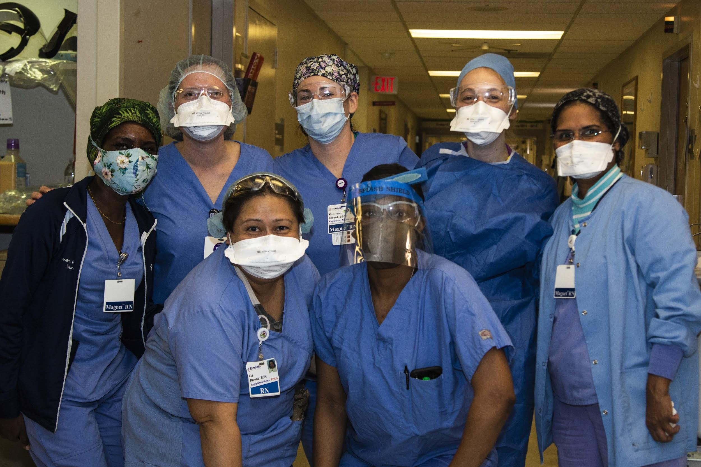
America’s nursing shortage is a crisis in the making.
Training nurses to be leaders could solve it.
Simply put, investing in nursing is a smart business decision in health care. Solving the nursing shortage does not come down to creating more nurses—we educate plenty of them. The reason we lose half our trained nurses each year is that we fail to invest in them. It’s time for the health care system to see nurses for the resource they are: intelligent, compassionate, dedicated, and hardworking professionals who became nurses because they wanted to save patients’ lives and take care of others.

Slide 13
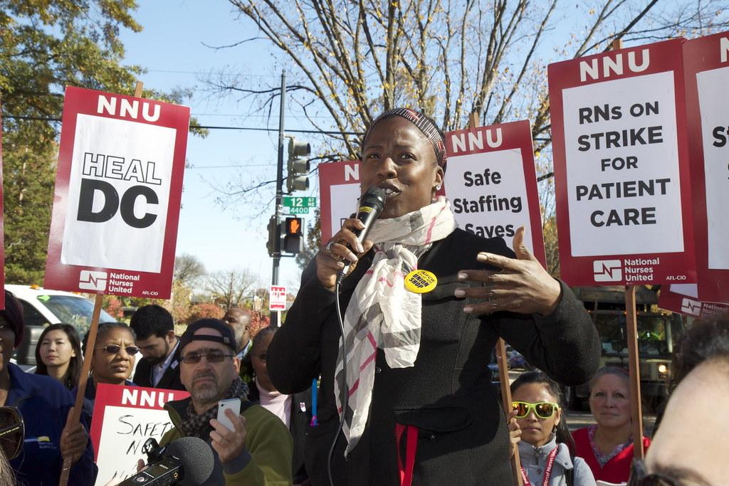
Unionized Nurses
“Joining a healthcare system with a nursing union can be beneficial to nurses. The goal of a union is to improve:
Working conditions
Wages
Benefits
Working hours
Unions not only benefit nurses but also to the healthcare system. According to a recent study by Dave Belman, unions mean increased productivity for the employer with better training, less turnover, and longer tenure of the workforce.”(Gaines, 2019)
“Nursing unions, while prominent in some states, are not an option for all registered nurses. California currently has one of the largest and strongest nursing unions in the country. According to the California Nurses Association/National Nurses Organizing Committee (CNA/NNOC) website, it is one of the fastest-growing labor and professional organizations in the US. With a membership of over 100,000 nurses, the CNA has grown nearly 400 percent in the last 15 years.”(Gaines, 2019)

Slide 14
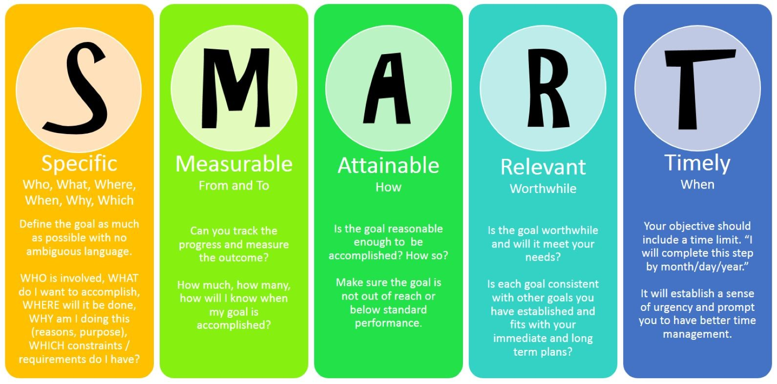
The SMART Goals Tool can be used by healthcare facilities to determine possible goals to potentially fix their nursing shortages.

Slide 15

Importance of Follow-Up
Evaluating these initiatives can obtain important information of the effectiveness of the implementation of the initiative. Even if these initiatives fail, we can further observe what worked as opposed to what didn’t. This allows us to remove any obstacles and make room for improvement; as well as, long lasting changes for the future.
The evaluation process can help us understand important aspects of the initiative, such as where we succeeded and where we fell short. This can encourage others to adapt the successful initiatives and bring light to these important issues and solutions.
Evaluating what plans of action are well received and performed efficiently, can help maintain the longevity of nursing staff .

Slide 16
Evaluation Methods
Administering satisfaction surveys and feedback forms can help to identify areas of improvement
Questionnaires and Self- Reporting guides can help evaluate if nurses are happy within the company they are employed in order to reduce the ongoing nursing shortage.
Develop a SMART Goal to help identify if all aspects of the initiative set in place were met.
According to the CDC, “the systematic collection of information about the activities, characteristics, and outcomes of programs to make judgments about the program, improve program effectiveness, and/or inform decisions about future program development” (Centers for Disease Control and Prevention, 2012, p.1).

Slide 17
References
American Association of Colleges of Nursing. (2020, September). Nursing shortage. https://www.aacnnursing.org/News-Information/Fact-Sheets/Nursing-Shortage
Centers for Disease Control and Prevention. (2012). Program evaluation guide – introduction – CDC. Centers for disease control and prevention. https://www.cdc.gov/eval/guide/introduction/index.htm.
Gaines, K. (2019, October 7). Nurses Unionizing: Benefits of working in a Union Hospital. Nurse.org. https://nurse.org/articles/benefits-of-nursing-union-hospital/
Love, R., & Pianko, D. (2021, May 18). Commentary: America's nurse shortage is a looming crisis. Training nurses to be leaders could solve it. Fortune. https://fortune.com/2021/05/18/nurse-shortage-retirement-crisis-covid-training-leadership/
Nursing shortage SOLUTIONS: Where do we go from here? FierceHealthcare. (2019, August 29). https://www.fiercehealthcare.com/sponsored/nursing-shortage-solutions-where-do-we-go-from-here
Online Master of Science in Nursing. (2020, October 20). Impact of the nursing shortage on patient care. Ohio University. https://onlinemasters.ohio.edu/blog/impact-of-nursing-shortage-on-patient-care/
Peters, A., Palomo, R. & Pittet, D. The great nursing brain drain and its effects on patient safety. Antimicrob Resist Infect Control 9, 57 (2020). https://doi.org/10.1186/s13756-020-00719-4
Sigma Theta Tau International Honor Society of Nursing. (2021). Facts on the Nursing Shortage in North America. Sigma Global Nursing Excellence . https://www.sigmanursing.org/why-sigma/about-sigma/sigma-media/nursing-shortage-information/facts-on-the-nursing-shortage-in-north-americ
University of St. Augustine for Health Sciences. (2021, May). The 2021 American Nursing Shortage: a data study. USAHS. https://www.usa.edu/blog/nursing-shortage/

